Slide 1
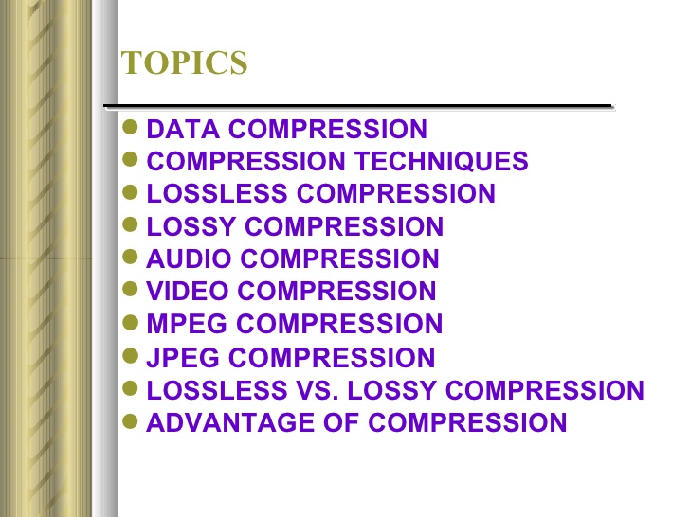

Slide 2
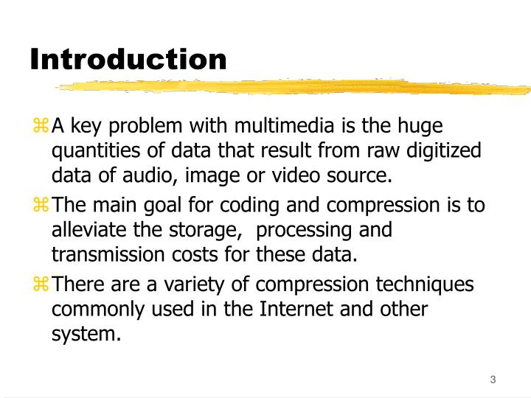

Slide 3
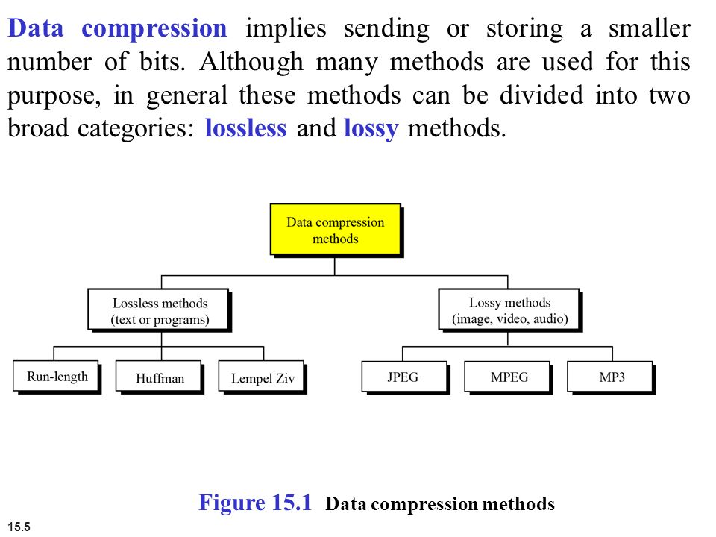

Slide 4
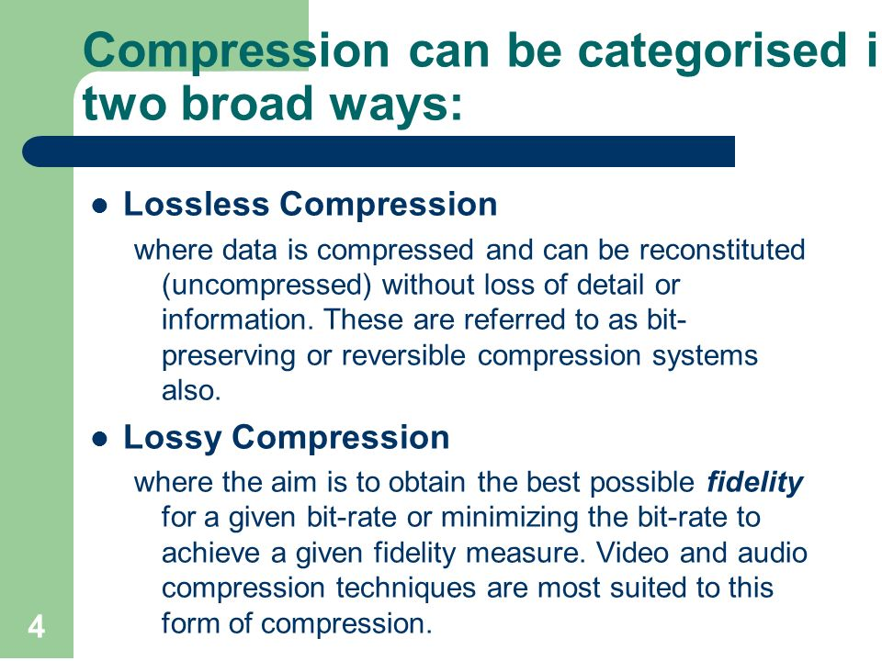

Slide 5
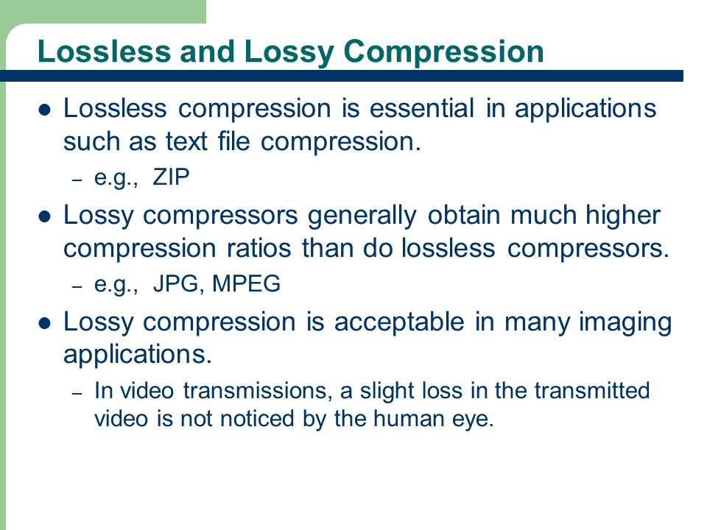

Slide 6
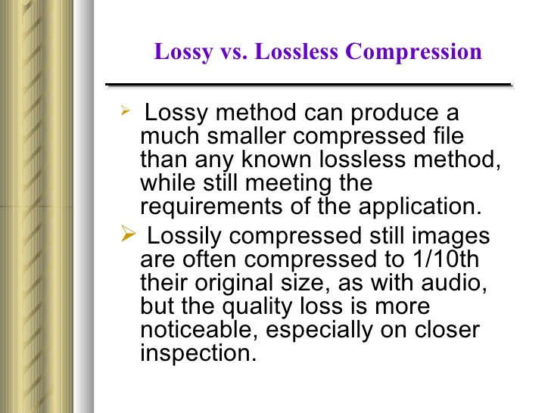

Slide 7
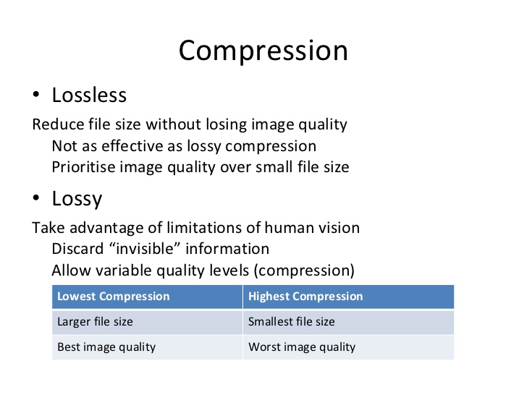

Slide 8
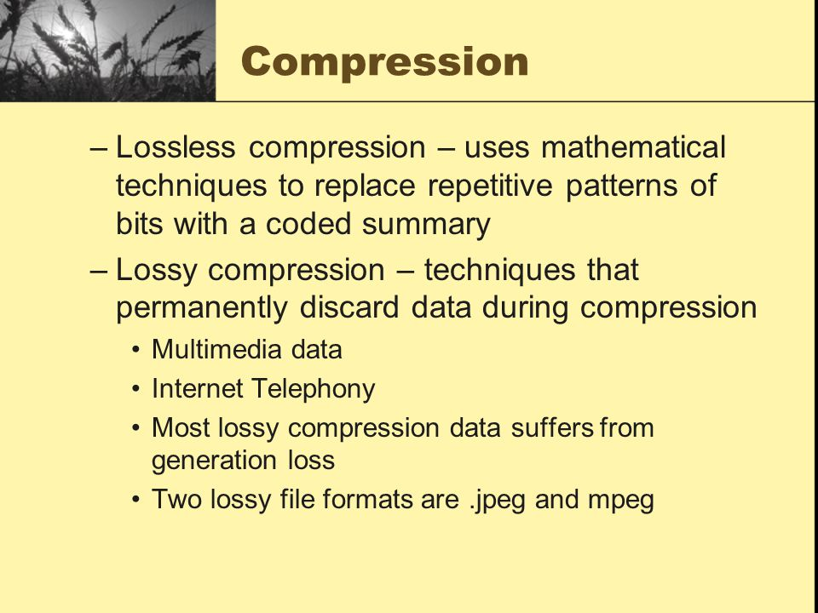

Slide 9
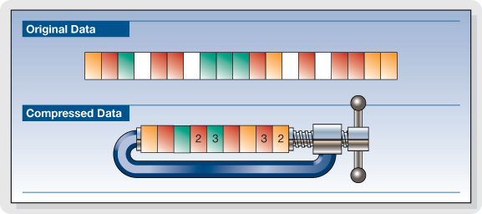

Slide 10
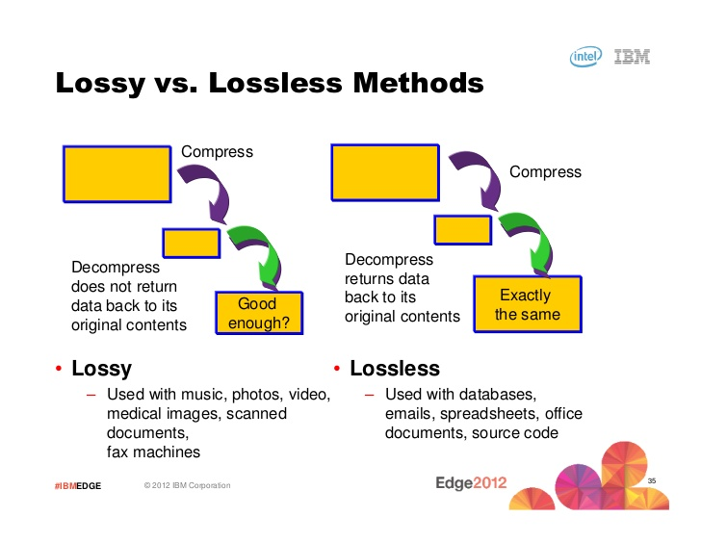

Slide 11
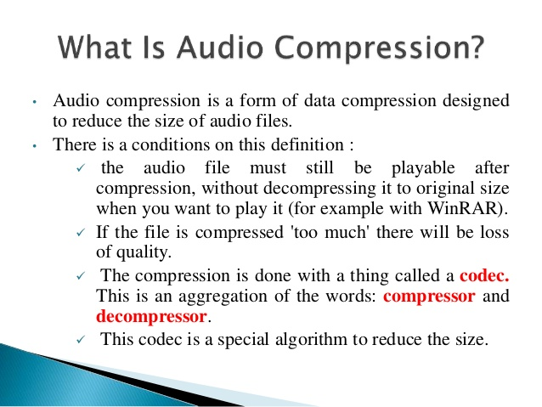

Slide 12
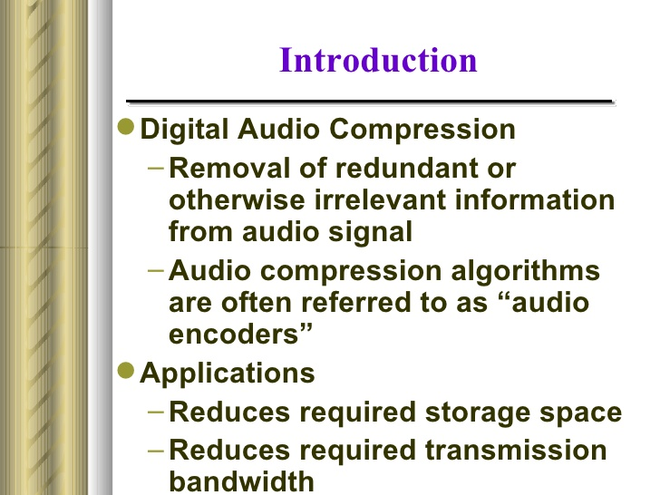

Slide 13
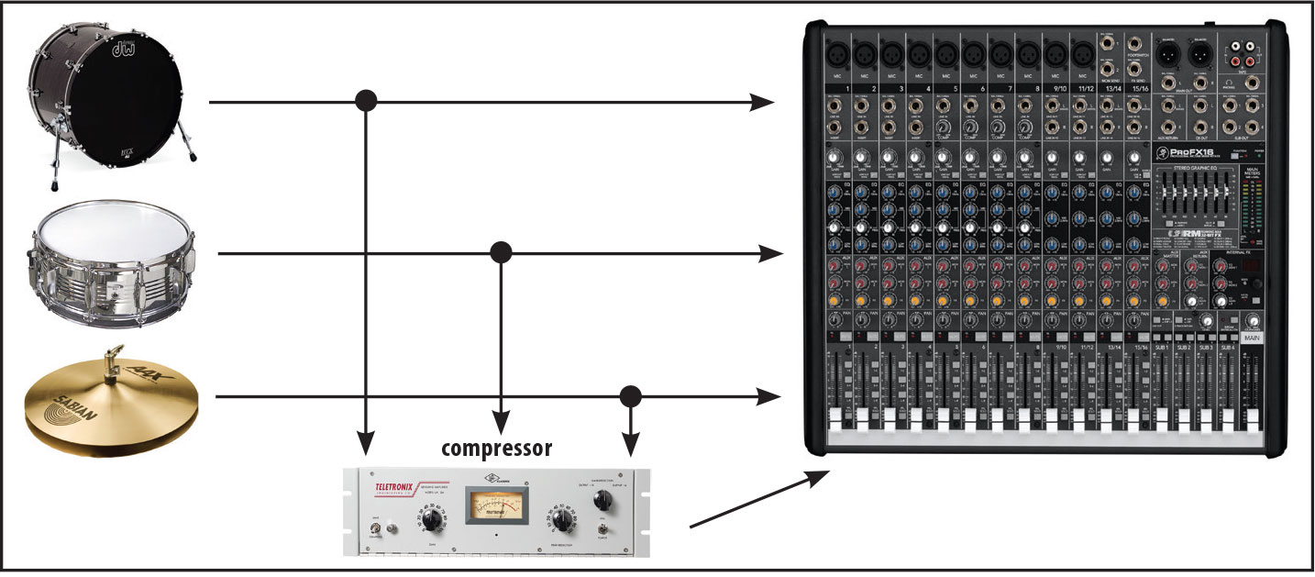

Slide 14
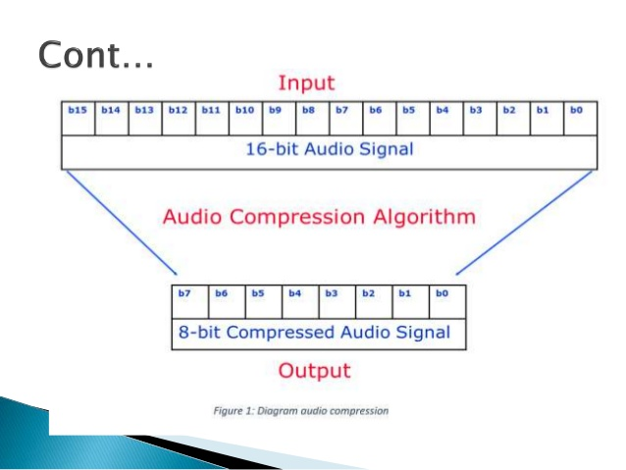

Slide 15
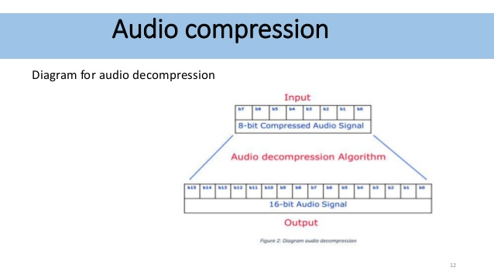

Slide 16
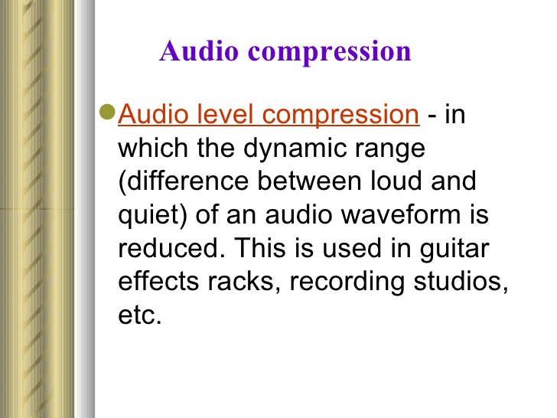

Slide 17
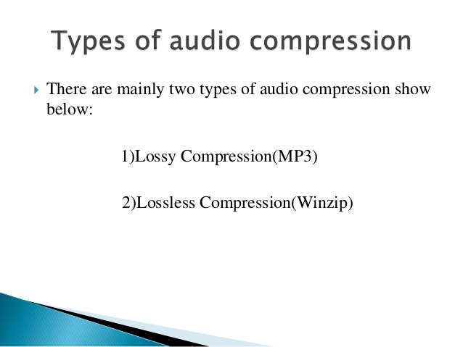

Slide 18
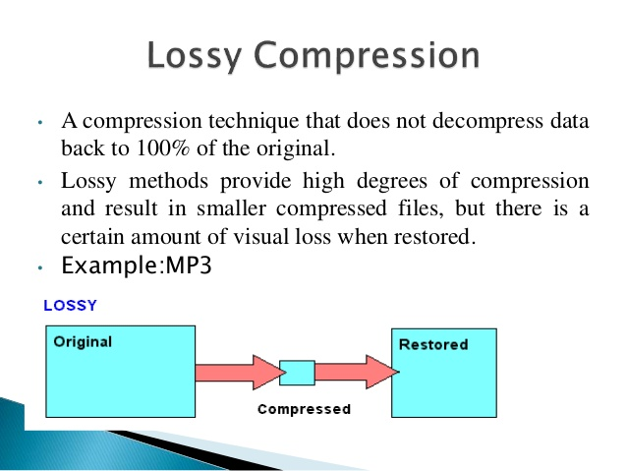

Slide 19
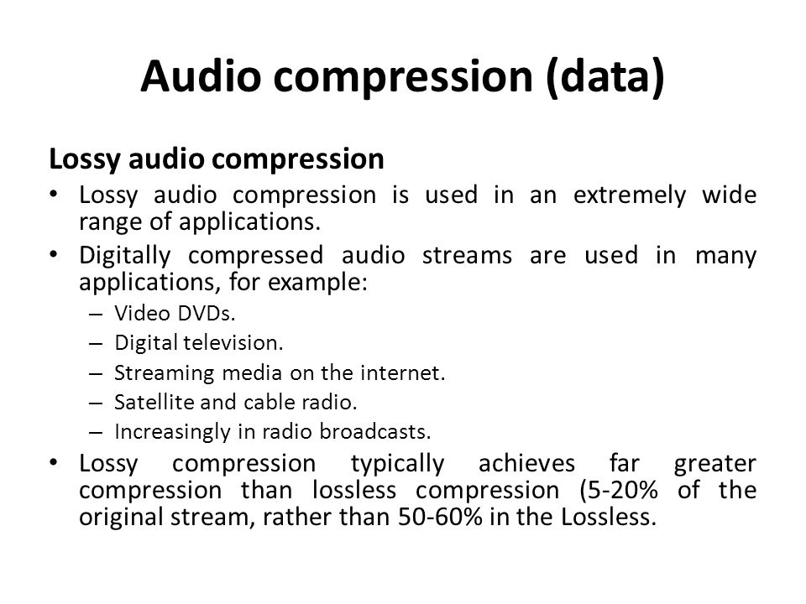

Slide 20
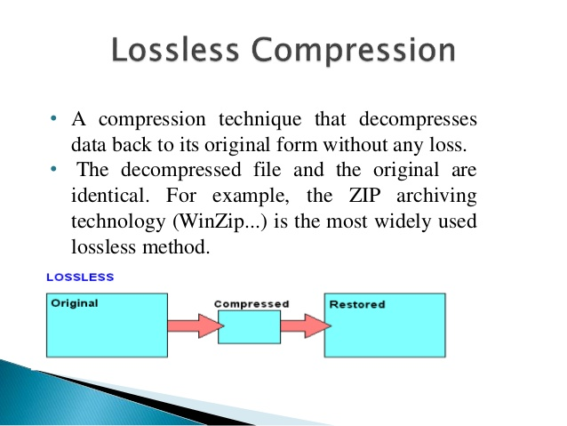

Slide 21
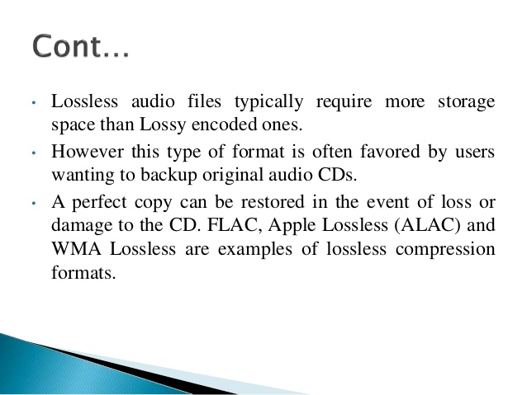

Slide 22
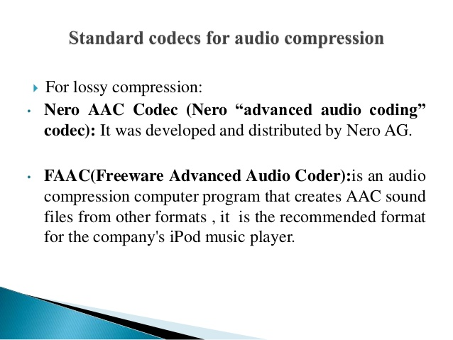

Slide 23
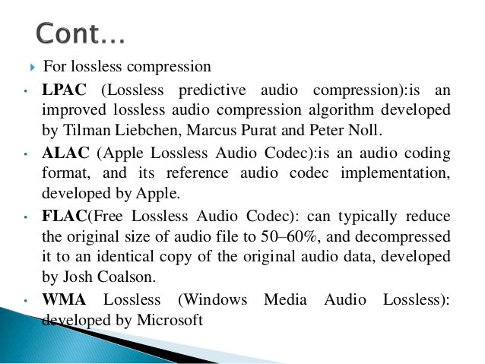

Slide 24
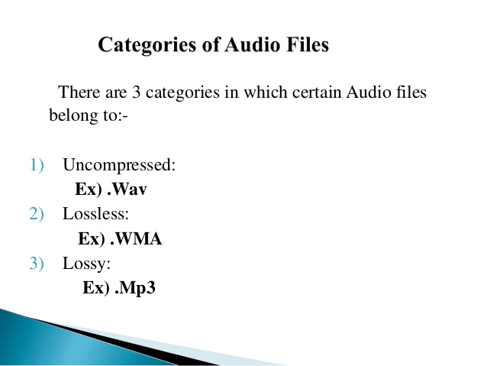

Slide 25
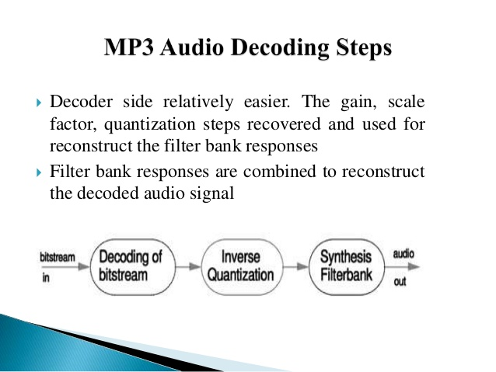

Slide 26
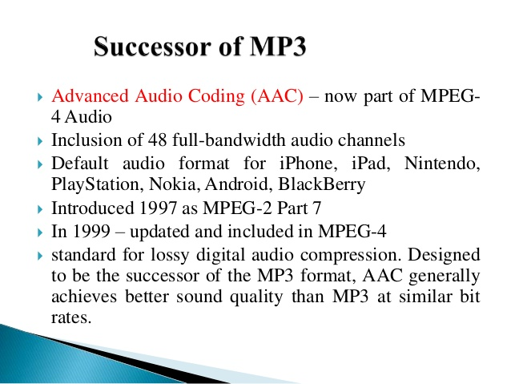

Slide 27
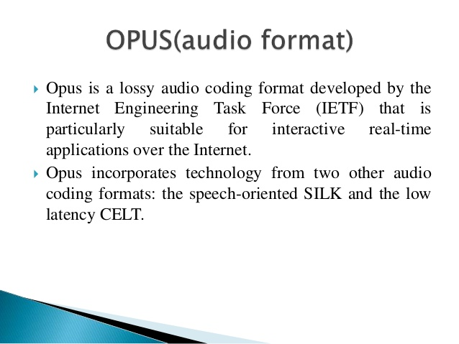

Slide 28
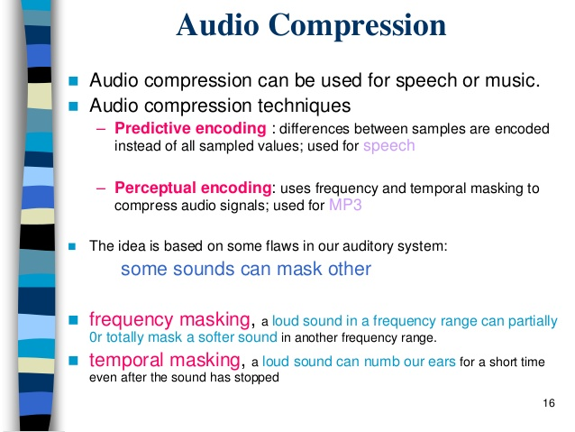

Slide 29
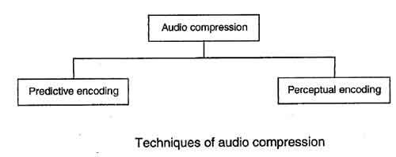

Slide 30
Audio compression
Audio compression can be used for speech or music. For speech we need to compress a 64 kHz digitized signal, while for music we need to compress a 1.411 MHz signal. Two categories of techniques are used for audio compression: predictive encoding and perceptual encoding.

Slide 31
Predictive encoding
In predictive encoding, the differences between samples are encoded instead of encoding all the sampled values. This type of compression is normally used for speech. Several standards have been defined such as GSM (13 kbps), G.729 (8 kbps), and G.723.3 (6.4 or 5.3 kbps). Detailed discussions of these techniques are beyond the scope of this book.
Perceptual encoding: MP3
The most common compression technique used to create CD-quality audio is based on the perceptual encoding technique. This type of audio needs at least 1.411 Mbps, which cannot be sent over the Internet without compression. MP3 (MPEG audio layer 3) uses this technique.

Slide 32
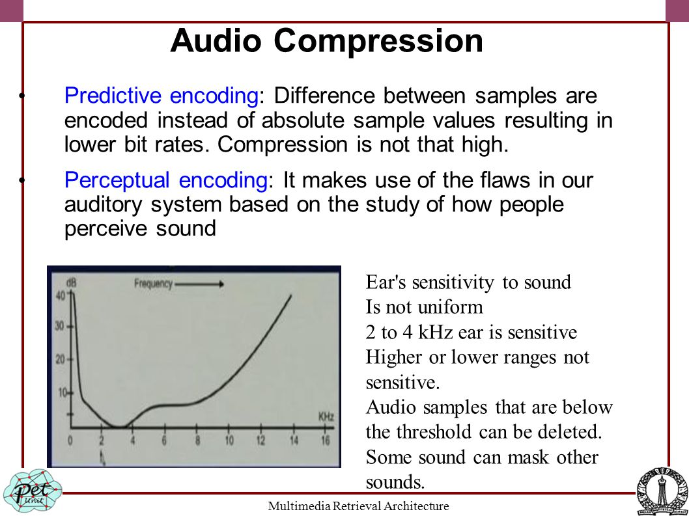

Slide 33
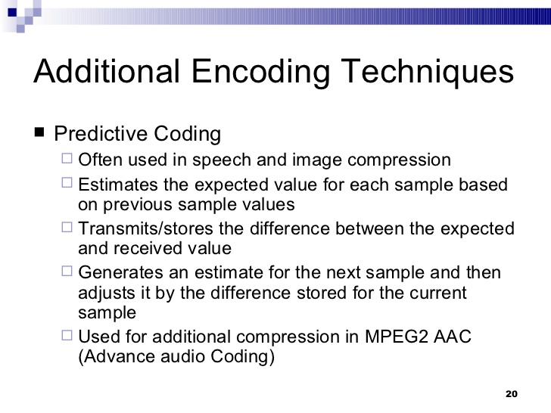

Slide 34
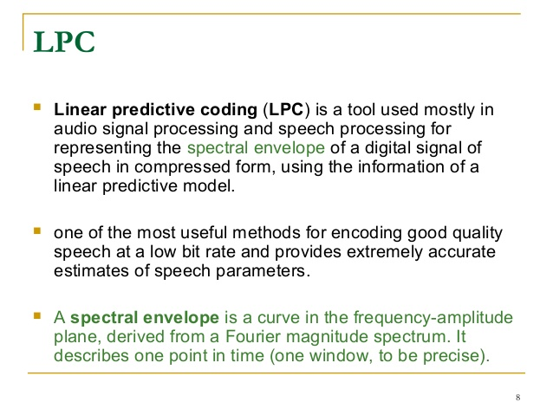

Slide 35
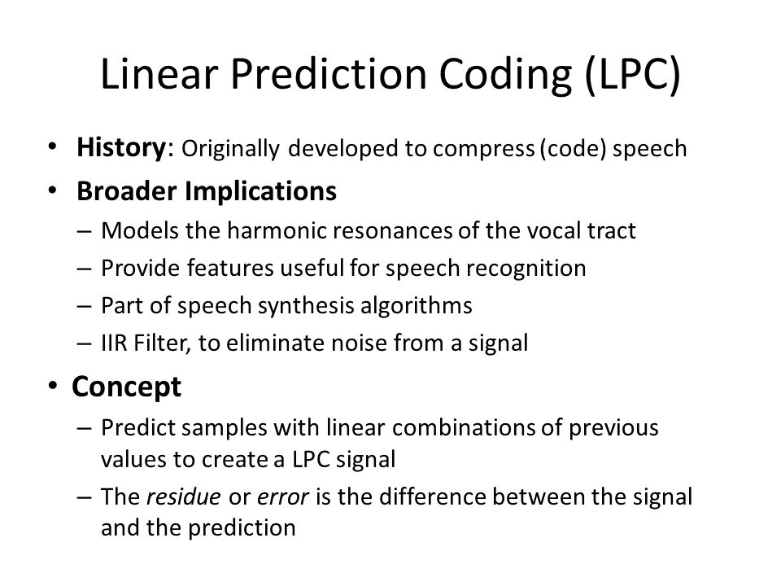

Slide 36
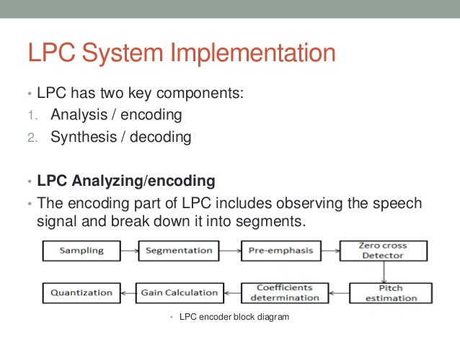

Slide 37

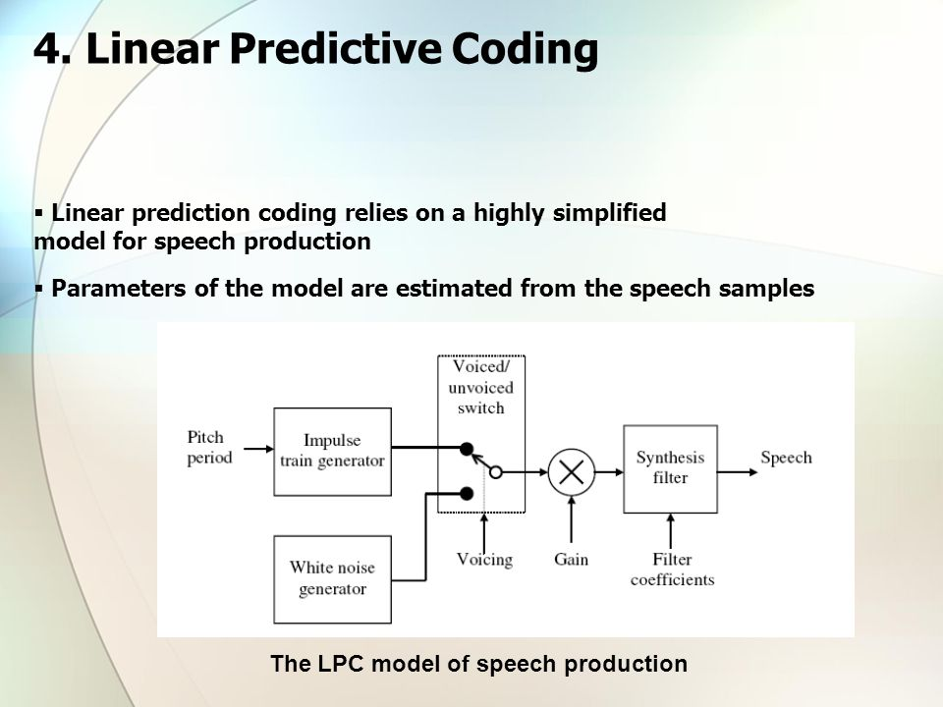

Slide 38
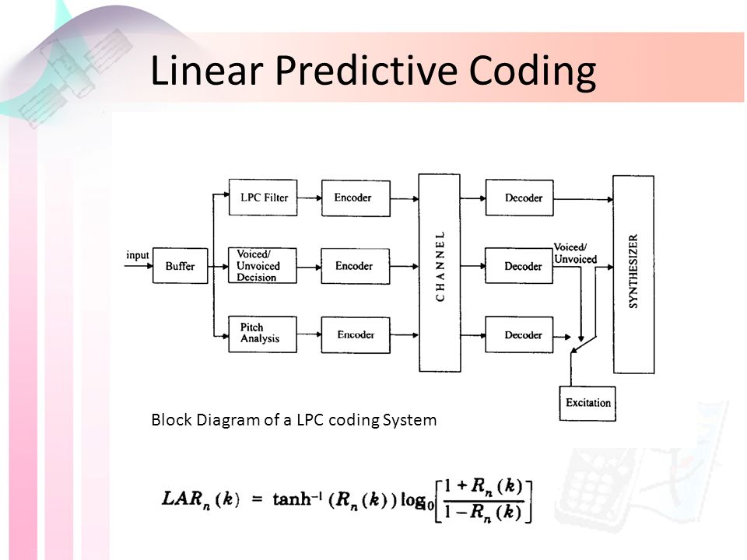

Slide 39
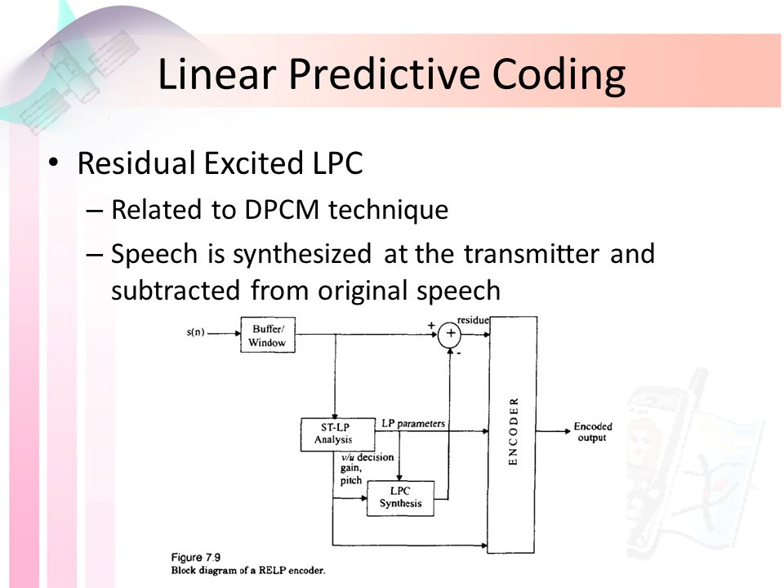

Slide 40
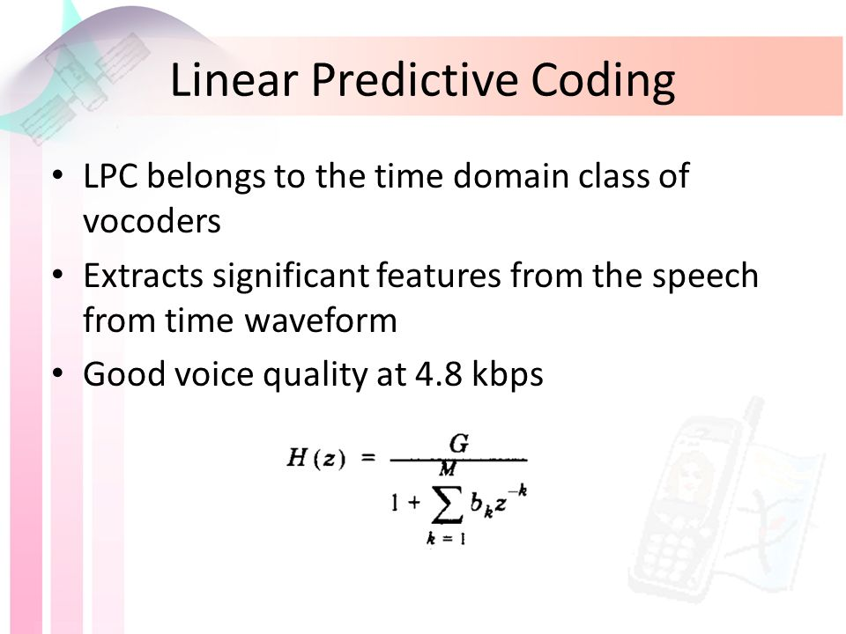

Slide 41
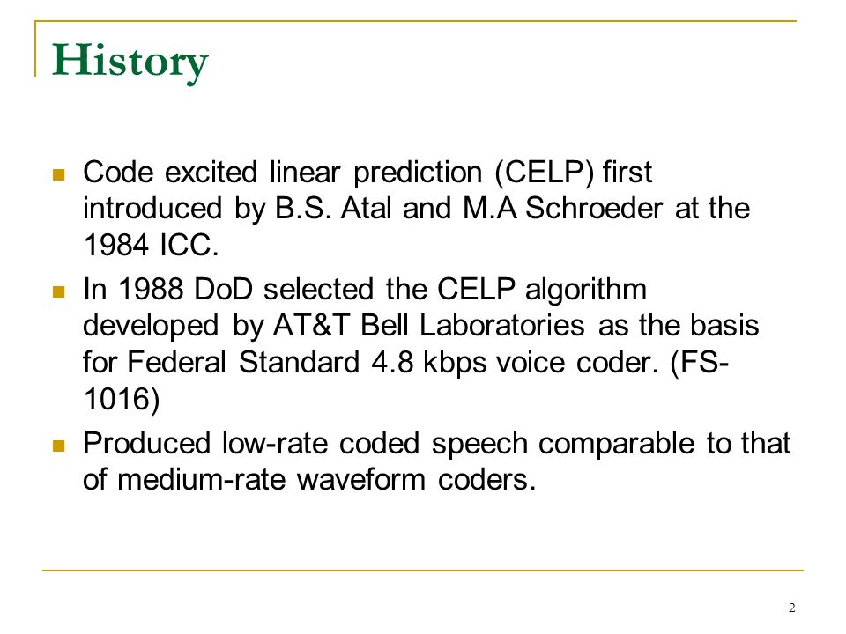

Slide 42
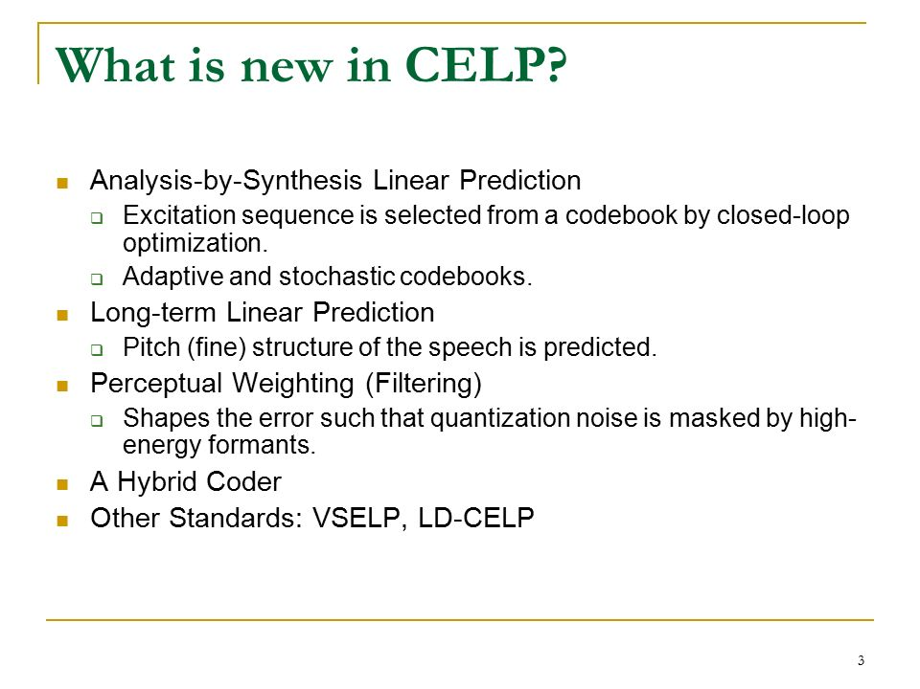

Slide 43
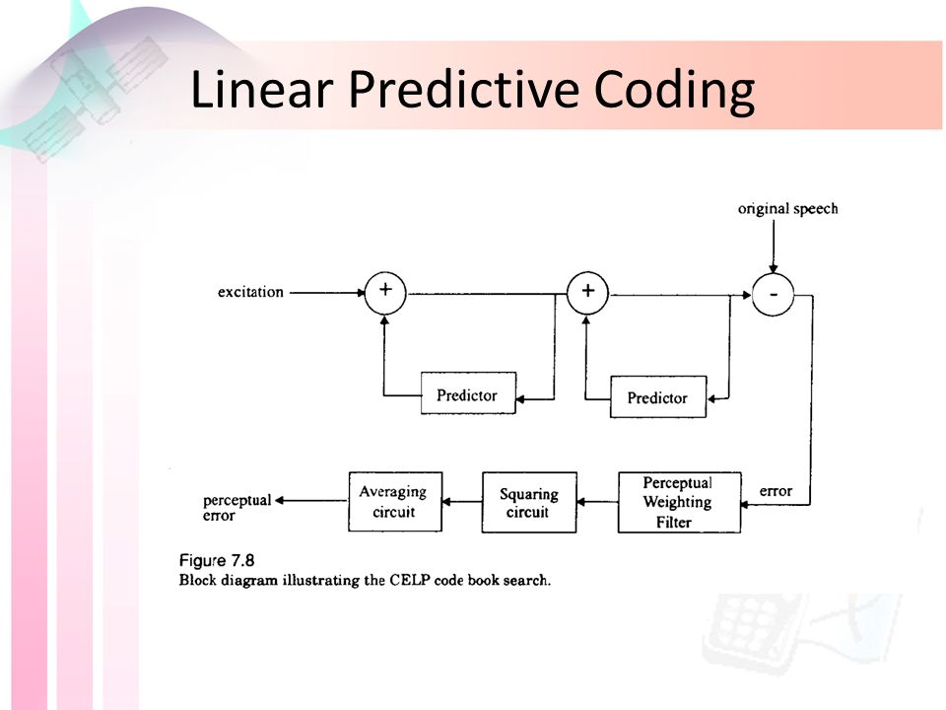

Slide 44
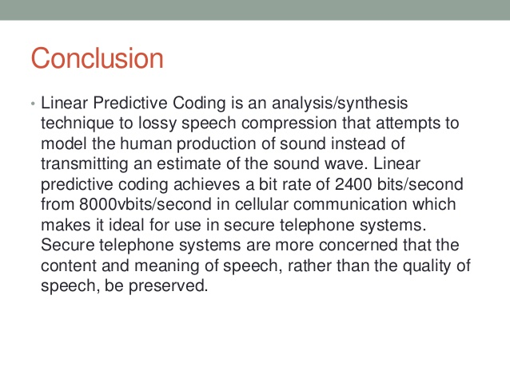

Slide 45
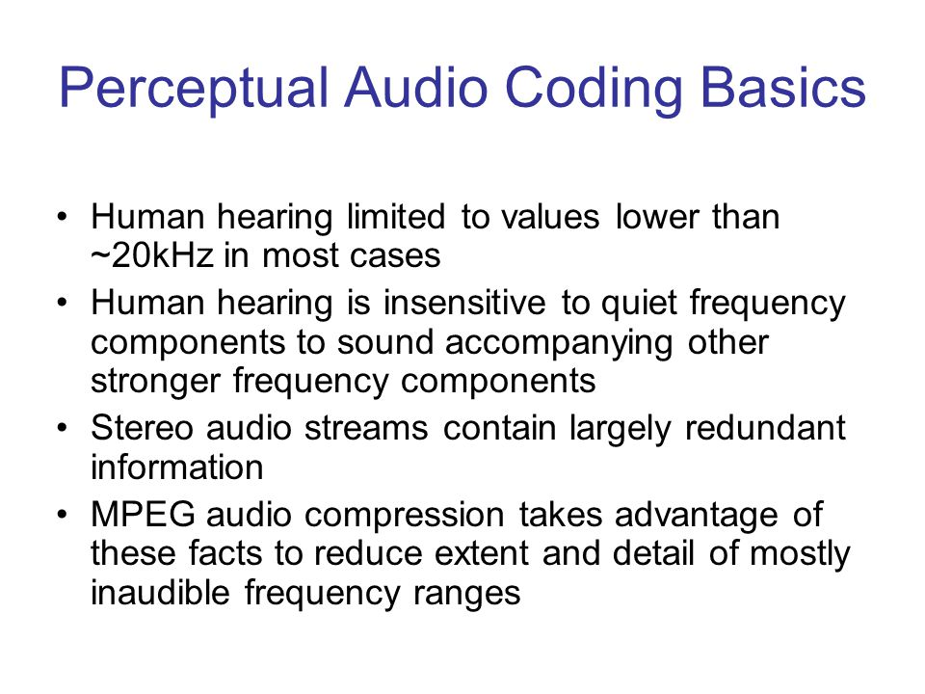

Slide 46
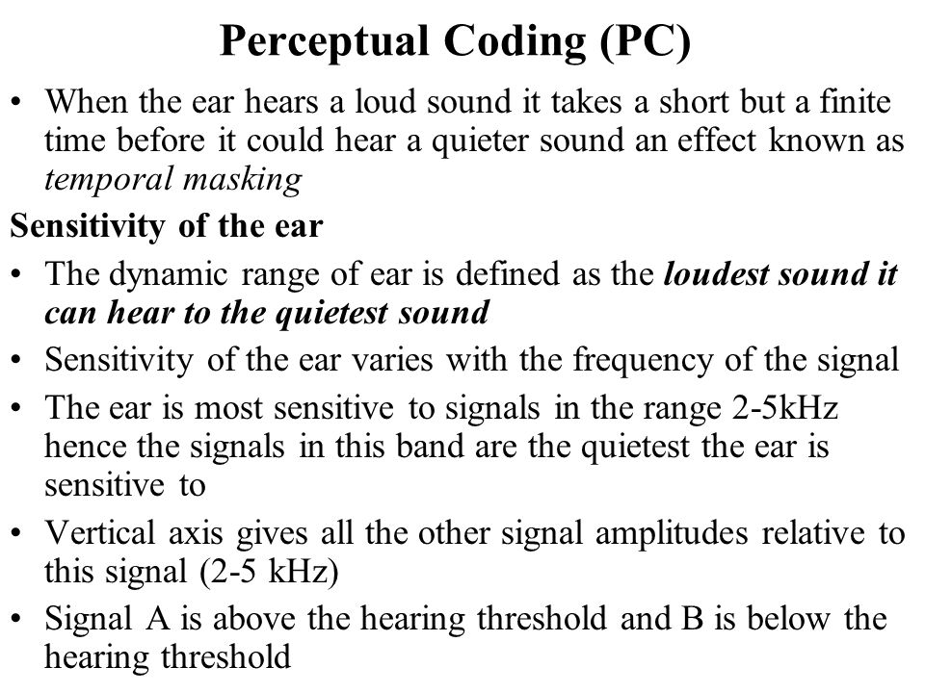

Slide 47
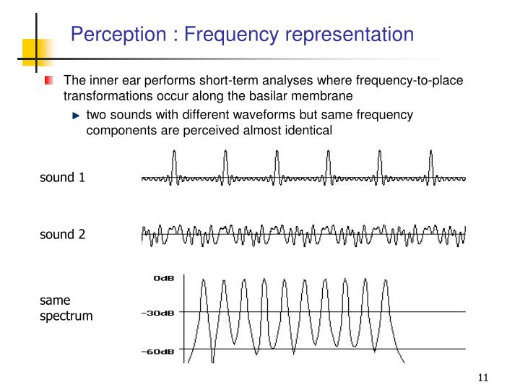

Slide 48
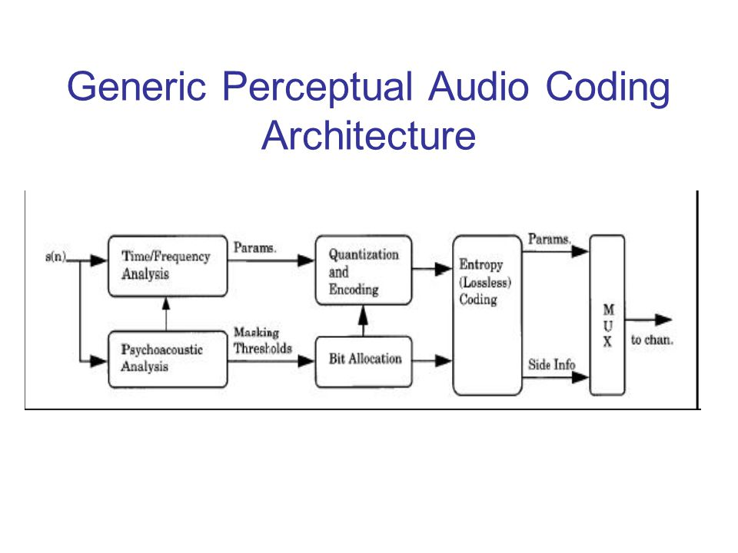

Slide 49
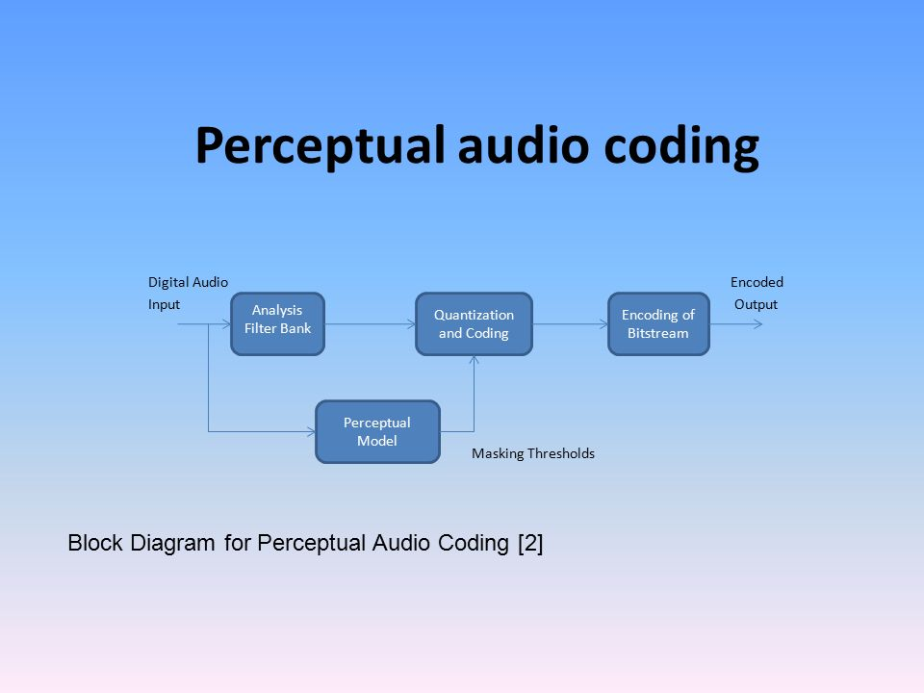

Slide 50
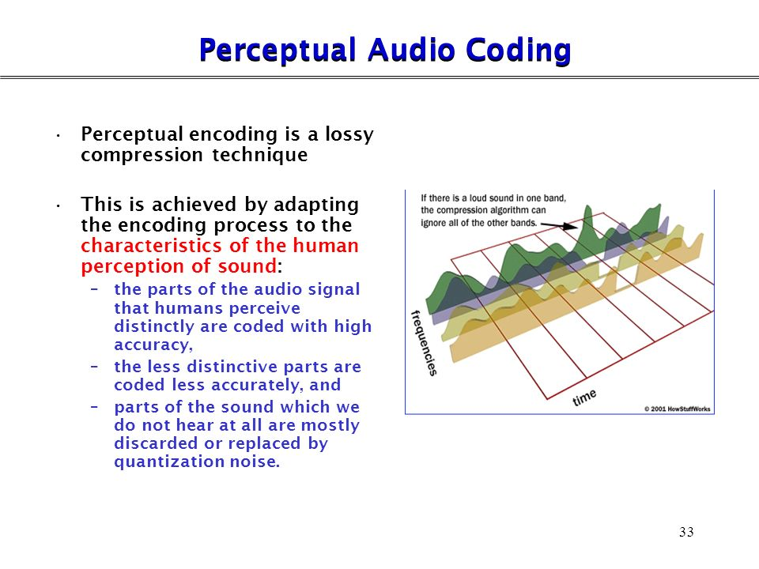

Slide 51
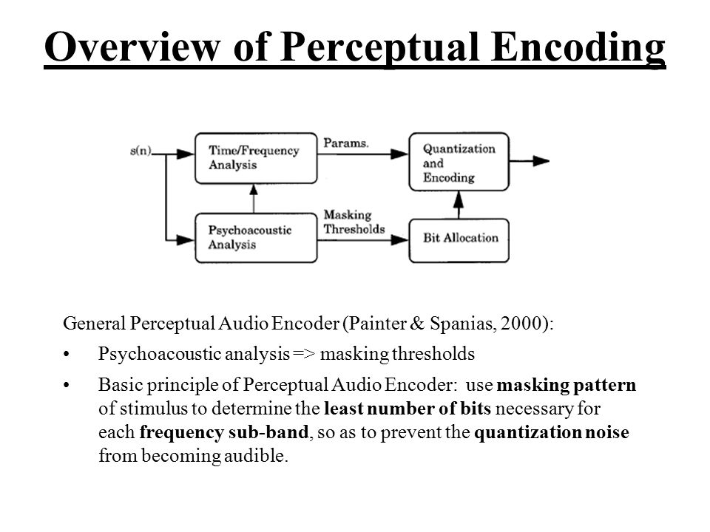

Slide 52
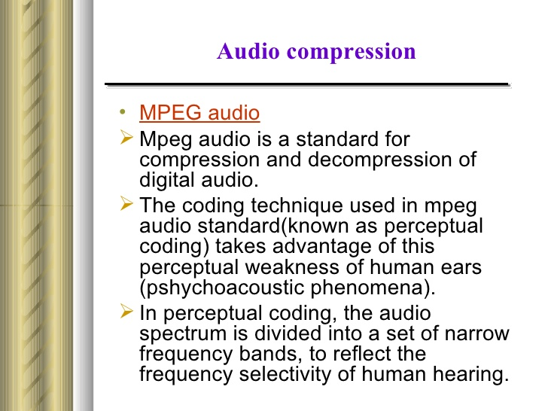

Slide 53


Slide 54


Slide 55
Figure 1. The masking effects in the frequency domain. A masker inhibits perception of coexisting signals below the masking threshold.

Slide 56


Slide 57
Figure 2. The masking effects in the time domain. Masking occurs both before and after the masking signal.

Slide 58


Slide 59


Slide 60


